Slide 1
Graphical user interface for command line
CSA0491 -Operating Systems for Process Scheduling
Team members- S. Dhana Prakash
V. Harish
E. keerthana
Course Faculty-Dr.G.Mary Valentina

Slide 2
Abstract-
Developing an intuitive Graphical User Interface (GUI) project aimed at enhancing user experience by seamlessly integrating visually appealing design with user-friendly functionalities. This project focuses on streamlining navigation through an intuitive layout, implementing responsive elements for diverse devices, and prioritizing user engagement. The GUI project strives to create a visually cohesive and aesthetically pleasing interface, ensuring a seamless interaction between users and the application, ultimately optimizing usability and satisfaction. The GUI project employs modern design principles to enhance accessibility and incorporates interactive features to promote user engagement. With a focus on responsiveness and efficiency, this project aims to deliver a cutting-edge graphical interface that elevates the overall user experience

Slide 3
Introduction-
Introducing a Graphical User Interface (GUI) for the command line—a transformative approach bridging the gap between traditional command-line environments and visually intuitive interfaces. This innovation simplifies and enhances user interactions with command-line tools, providing a graphical layer that promotes ease of use and accessibility. By combining command-line functionality with a graphical interface, users can seamlessly navigate and execute commands, unlocking a more user-friendly and efficient computing experience. The GUI offers a visual representation of command structures, democratizing command-line functionalities for a broader user base while retaining the efficiency and flexibility of traditional operations. Leveraging icons, buttons, and menus, it translates intricate command syntax into easily understandable actions, reducing the learning curve for users new to command-line operations.

Slide 4
Understanding the problem -
01
Complexity of Command Line: Many users find traditional command-line interfaces daunting and difficult to navigate due to complex command structures and syntax.
02
Limited Accessibility: Command-line interfaces often require a steep learning curve, restricting access to users who are not familiar with command-based interactions.
03
Lack of Intuitive Interaction: Without visual aids, understanding and executing commands can be challenging, especially for beginners, leading to errors and inefficiencies in computing tasks.

Slide 5
PROCESS-
1. User-Centered Design:
- Research-driven approach to cater to user needs and preferences.
- Tailored GUI design to enhance usability and address common pain points.
2. Iterative Development:
- Wireframing, prototyping, and user feedback for continuous improvement.
- Usability testing ensures alignment with user expectations.
3. Seamless Integration and Support:
- Close collaboration with developers for smooth integration with command-line functionalities.
- Clear documentation, guides, and user support for effective utilization.
- Ongoing training ensures successful adoption of the GUI.

Slide 6
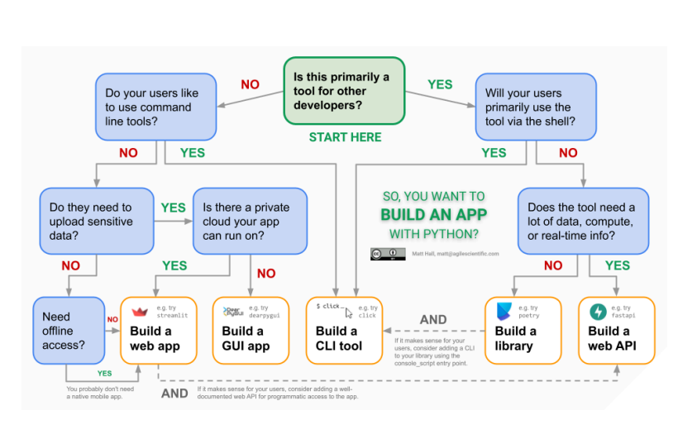
Diagram-

Slide 7
OBJECTIVE-
The primary objective of creating a Graphical User Interface (GUI) application is to enhance user interaction and usability by providing a visual and intuitive platform for users to interact with software or systems. GUIs aim to simplify complex functionalities, making it more accessible for users who may not be familiar with command-line interfaces or coding. By incorporating graphical elements such as icons, buttons, and menus, GUI applications enable users to perform tasks efficiently and with minimal technical expertise. Additionally, GUIs contribute to a more immersive and engaging user experience, fostering user satisfaction and productivity. They provide a visually cohesive and organized representation of data, controls, and information, facilitating effective communication between the user and the software. Ultimately, the goal of developing a GUI application is to optimize usability, streamline workflows, and cater to a broader audience by creating an interface that is both user-friendly and visually appealing.

Slide 8
Future scope -
1. Augmented Reality Integration: Exploring the incorporation of augmented reality (AR) into GUI design, offering users immersive command-line interactions through AR headsets or devices.
2. AI-Powered Assistance: Implementing AI algorithms to provide contextual assistance and predictive suggestions, enhancing user efficiency and reducing errors in command execution.
3. Blockchain-Based Security: Leveraging blockchain technology to ensure data integrity, authentication, and secure transactions within the GUI environment, enhancing trust and security for users interacting with command-line tools.

Slide 9
CONCLUSION-
Fig 1 represents how the process being carried out in designing a web application of Graphical user Interface (GUI) for Command line. In conclusion, GUI design is a critical aspect of user experience, requiring a delicate balance between simplicity and functionality. The literature underscores the iterative nature of the design process, emphasizing the importance of understanding user needs. Responsive and adaptive designs, coupled with a commitment to accessibility, reflect the evolving landscape of GUI applications. As technology advances, the fusion of aesthetics and practical usability remains pivotal for creating engaging and satisfying user interfaces. Ongoing research and implementation efforts should continue to align with emerging technologies and evolving user expectations.

Slide 10

Thank you!
S. Dhana Prakash
V.Harish
E.keerthana

